Slide 1
Chapter 12: Physical Storage Systems

Slide 2
Outline
Classification of Physical Storage Media
Storage Hierarchy
Magnetic Disks
  Disk Interface Standards
  Performance Measures of Disks
  Optimization of Disk-Block Access
Flash Storage & SSD
Storage Class Memory(NVM)

Slide 3
Classification of Physical Storage Media
Can differentiate storage into:
  volatile storage(易失存储): loses contents when power is switched off
  non-volatile storage（非易失存储）:
    Contents persist even when power is switched off.
    Includes secondary and tertiary storage, as well as batter- backed up main-memory.
Speed with which data can be accessed
Cost per unit of data
Reliability
  data loss on power failure or system crash
  physical failure of the storage device

Slide 4
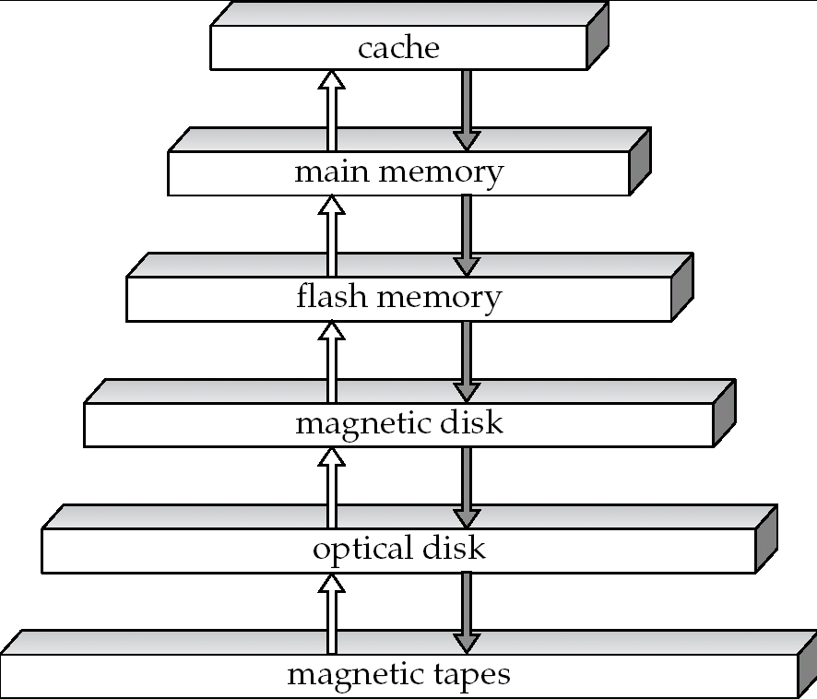
Storage Hierarchy（存储级别）
!!!
~ 1 ns
primary
storage
(一级存储)
volatile
storage
（易失存储）
!!!
~10² ns
NVM
secondary
storage
(二级存储 online
storage)
!!!
~10⁷ ns
non-volatile
storage
（非易失存储）
tertiary
storage
(三级存储
offline
storage)

Slide 5
Storage Hierarchy (Cont.)
primary storage: Fastest media but volatile (cache, main memory).
secondary storage: next level in hierarchy, non-volatile, moderately fast access time
  also called on-line storage
  E.g. flash memory, magnetic disks
tertiary storage: lowest level in hierarchy, non-volatile, slow access time
  also called off-line storage
  E.g. magnetic tape, optical storage

Slide 6

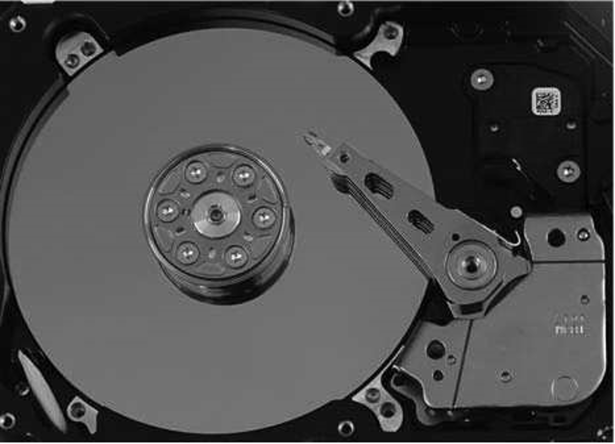
Magnetic Hard Disk Mechanism
Simplified Diagram of Disk Drives
Photo of magnetic disk drive

Slide 7
Magnetic Disks
Read-write head
  Positioned very close to the platter surface (almost touching it)
  Reads or writes magnetically encoded information.
Surface of platter divided into circular tracks（磁道）
  Over 50K-100K tracks per platter on typical hard disks
Each track is divided into sectors（扇区）.
  A sector is the smallest unit of data that can be read or written.
  Sector size typically 512 bytes
  Typical sectors per track: 500 to 1000 (on inner tracks) to 1000 to 2000 (on outer tracks)
To read/write a sector
  disk arm swings to position head on right track
  platter spins continually; data is read/written as sector passes under head
Head-disk assemblies
  multiple disk platters on a single spindle (1 to 5 usually)
  one head per platter, mounted on a common arm.
Cylinder（柱面） i consists of i^{th} track of all the platters

Slide 8

Magnetic Disks (Cont.)
Disk controller(磁盘控制器) – interfaces between the computer system and the disk drive hardware.
  accepts high-level commands to read or write a sector
  initiates actions such as moving the disk arm to the right track and actually reading or writing the data
  Computes and attaches checksums to each sector to verify that data is read back correctly
    If data is corrupted, with very high probability stored checksum won’t match recomputed checksum
  Ensures successful writing by reading back sector after writing it
  Performs remapping of bad sectors

Slide 9
Disk Interface Standards
Disk interface standards families
  SATA (Serial ATA)
    SATA 3 supports data transfer speeds of up to 6 gigabits/sec
  SAS (Serial Attached SCSI)
    SAS Version 3 supports 12 gigabits/sec
  NVMe (Non-Volatile Memory Express) interface
    Works with PCIe connectors to support lower latency and higher transfer rates
    Supports data transfer rates of up to 24 gigabits/sec
Disks usually connected directly to computer system
In Storage Area Networks (SAN), a large number of disks are connected by a high-speed network to a number of servers
In Network Attached Storage (NAS) networked storage provides a file system interface using networked file system protocol, instead of providing a disk system interface

Slide 10
Performance Measures of Disks
Access time(访问时间) – the time it takes from when a read or write request is issued to when data transfer begins. Consists of:
  Seek time（寻道时间） – time it takes to reposition the arm over the correct track.
    Average seek time is 1/2 the worst case seek time.
    4 to 10 milliseconds on typical disks
  Rotational latency （旋转延迟）– time it takes for the sector to be accessed to appear under the head.
    Average latency is 1/2 of the worst case latency.
    4 to 11 milliseconds on typical disks (5400 to 15000 r.p.m.)
Data-transfer rate（数据传输率） – the rate at which data can be retrieved from or stored to the disk.
  25 to 100 MB per second max rate, lower for inner tracks
  Multiple disks may share a controller, so rate that controller can handle is also important
    E.g. SATA: 150 MB/sec, SATA-II 3Gb (300 MB/sec)
    Ultra 320 SCSI: 320 MB/s, SAS (3 to 6 Gb/sec)
    Fiber Channel (FC2Gb or 4Gb): 256 to 512 MB/s

Slide 11
Performance Measures of Disks（Cont.）
Disk block is a logical unit for storage allocation and retrieval
  4 to 16 kilobytes typically
    Smaller blocks: more transfers from disk
    Larger blocks: more space wasted due to partially filled blocks
Sequential access pattern(顺序访问模式)
  Successive requests are for successive disk blocks
  Disk seek required only for first block
Random access pattern（随机访问模式）
  Successive requests are for blocks that can be anywhere on disk
  Each access requires a seek
  Transfer rates are low since a lot of time is wasted in seeks
I/O operations per second (IOPS ，每秒I/O操作数)
  Number of random block reads that a disk can support per second
  50 to 200 IOPS on current generation magnetic disks

Slide 12
Performance Measures (Cont.)
Mean time to failure (MTTF，平均故障时间) – the average time the disk is expected to run continuously without any failure.
  Typically 3 to 5 years
  Probability of failure of new disks is quite low, corresponding to a
  “theoretical MTTF” of 500,000 to 1,200,000 hours （57 to 136 years）for a new disk
  An MTTF of 1,200,000 hours for a new disk means that given 1000 relatively new disks, on an average one will fail every 1200 hours(50 days)
  MTTF decreases as disk ages

Slide 13
Optimization of Disk-Block Access
Buffering: in-memory buffer to cache disk blocks
Read-ahead(Prefetch): Read extra blocks from a track in anticipation that they will be requested soon
Disk-arm-scheduling algorithms re-order block requests so that disk arm movement is minimized
  elevator algorithm
R6
R3
R1
R5
R2
R4
Inner track
Outer track

Slide 14
Optimization of Disk Block Access (Cont.)
File organization
  Allocate blocks of a file in as contiguous a manner as possible
  Allocation in units of extents(盘区）
  Files may get fragmented
    E.g., if free blocks on disk are scattered, and newly created file has its blocks scattered over the disk
    Sequential access to a fragmented file results in increased disk arm movement
    Some systems have utilities to defragment the file system, in order to speed up file access

Slide 15
Optimization of Disk Block Access (Cont.)
Nonvolatile write buffers （非易失性写缓存） – speed up disk writes by writing blocks to a non-volatile RAM buffer immediately
  Non-volatile RAM: battery backed up RAM or flash memory
    Even if power fails, the data is safe and will be written to disk when power returns
  Controller then writes to disk whenever the disk has no other requests or request has been pending for some time
  Database operations that require data to be safely stored before continuing can continue without waiting for data to be written to disk
  Writes can be reordered to minimize disk arm movement
Log disk（日志磁盘） – a disk devoted to writing a sequential log of block updates
  Used exactly like nonvolatile RAM
    Write to log disk is very fast since no seeks are required
    No need for special hardware (NV-RAM)

Slide 16
Flash Storage
NAND flash - used widely for storage, cheaper than NOR flash
  requires page-at-a-time read (page: 512 bytes to 4 KB)
    Not much difference between sequential and random read
  Page can only be written once
    Must be erased to allow rewrite
SSD(Solid State Disks)
  Use standard block-oriented disk interfaces, but store data on multiple flash storage devices internally
 | Magnetic Disk | Solid State Disk
Retrieve a page | 5-10 milliseconds | 20-100 microseconds
Random access | Random 50 to 200 IOPS | reads: 10,000 IOPS writes: 40,000 IOPS
Data transfer rate | 200M | 500M(SATA), 3G(NVMe)
Power consumption | higher | lower
Update mode | in place | erase → rewrite
Realiability | MTTF : 500,000 to 1,200,000 hours | erase blocks: 100,000 to 1,000,000 erases

Slide 17
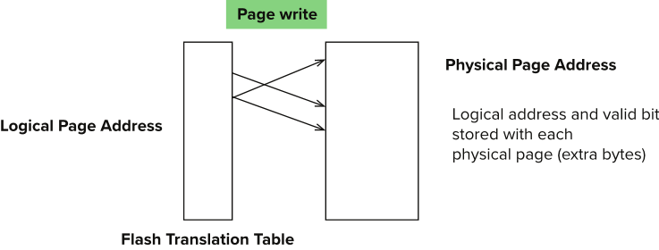
Flash Storage (Cont.)
Erase happens in units of erase block
  Takes 2 to 5 milliseconds
  Erase block typically 256 KB to 1 MB (128 to 256 pages)
  After 100,000 to 1,000,000 erases, erase block becomes unreliable and cannot be used
Remapping of logical page addresses to physical page addresses avoids waiting for erase
Flash translation table tracks mapping
  also stored in a label field of flash page
  remapping carried out by flash translation layer
wear leveling(磨损均衡)- evenly distributed erase operators across physical blocks
Notes:
Where is FTL stored? How is it reconstructed on system startup?
How to track number of erases per block (extra storage per block)

Slide 18
Storage Class Memory(NVM)
3D-XPoint memory technology pioneered by Intel
Available as Intel Optane
  SSD interface shipped from 2017
    Allows lower latency than flash SSDs
  Non-volatile memory interface announced in 2018
    Supports direct access to words, at speeds comparable to main-memory speeds
 | DRAM | NVM | SSD | HDD
Read Latency | １x | ２－４ｘ | 500x | 10⁵ x
Write Latency | １x | ２－８ｘ | 5000x | 10⁵ x
Persistence | No | Yes | Yes | Yes
Byte-Addressable | Yes | Yes | No | No
Endurance | Yes | No | No | Yes

Slide 19
End of Chapter 12

